Slide 1
New Maximum Flow Algorithms of MA Orderings and Scalings
Satoru Fujishige, Shigueo Isotani
Journal of the Operational Research
Presenter: Yu-Shian Chen

Slide 2
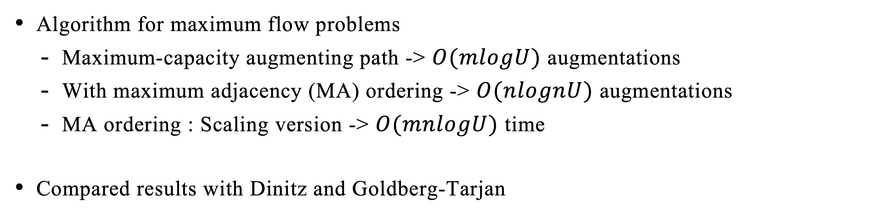
Introduction
Maximum Flow Problems
Algorithm for maximum flow problems
Maximum-capacity augmenting path -> $O(mlogU)$ augmentations
With maximum adjacency (MA) ordering -> $O(nlognU)$ augmentations
MA ordering : Scaling version -> $O(mnlogU)$ time
Compared results with Dinitz and Goldberg-Tarjan
1
4
3
2

Slide 3
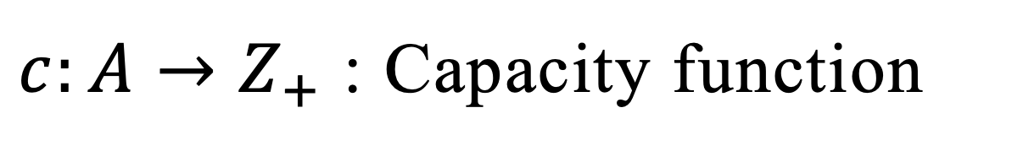
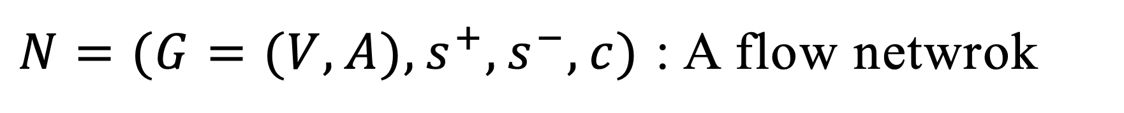
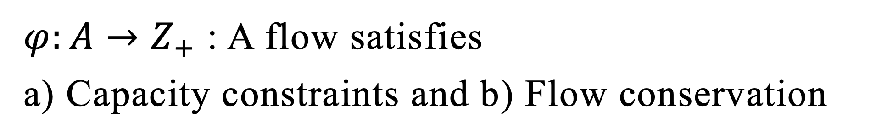
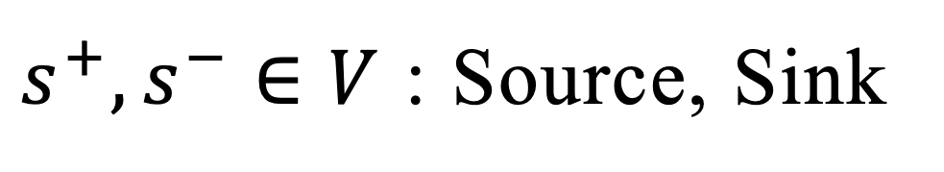
Maximum Flow
Maximum Flow and Residual Network
$N=(G=(V,A),s^{+},s^{−},c)$ : A flow netwrok
1
$s^{+},s^{−}∈V$ : Source, Sink
(8,8)
(8,7)
$c:A→Z_{+}$ : Capacity function
4
(1,1)
3
$φ:A→Z_{+}$ : A flow satisfies
a) Capacity constraints and b) Flow conservation
(6,5)
2
(10,6)
(capacity, flow)

Slide 4
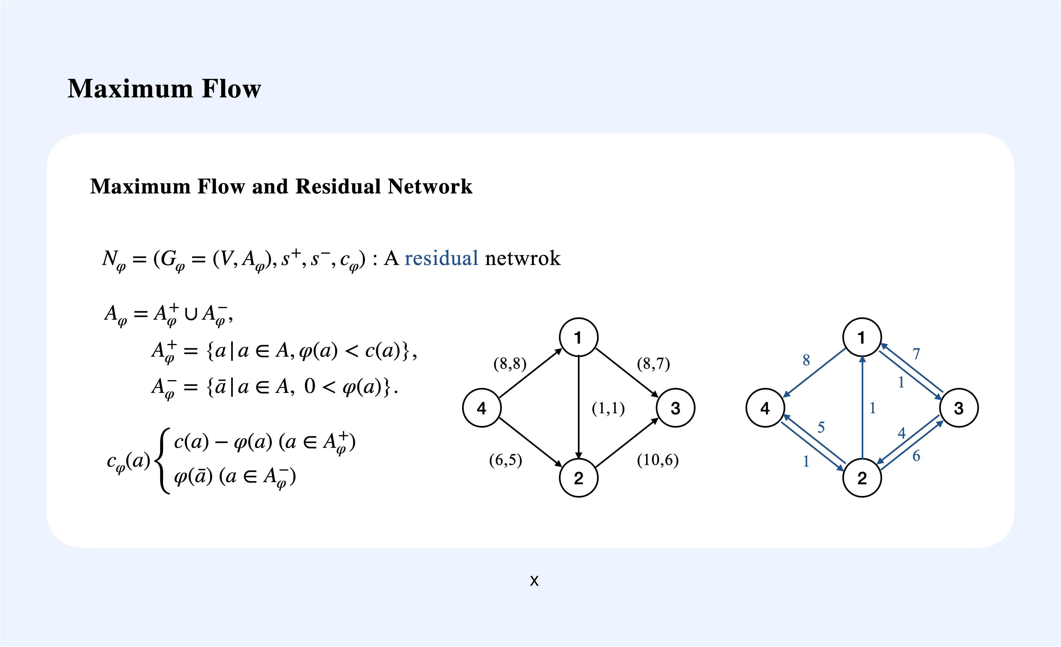

Slide 5
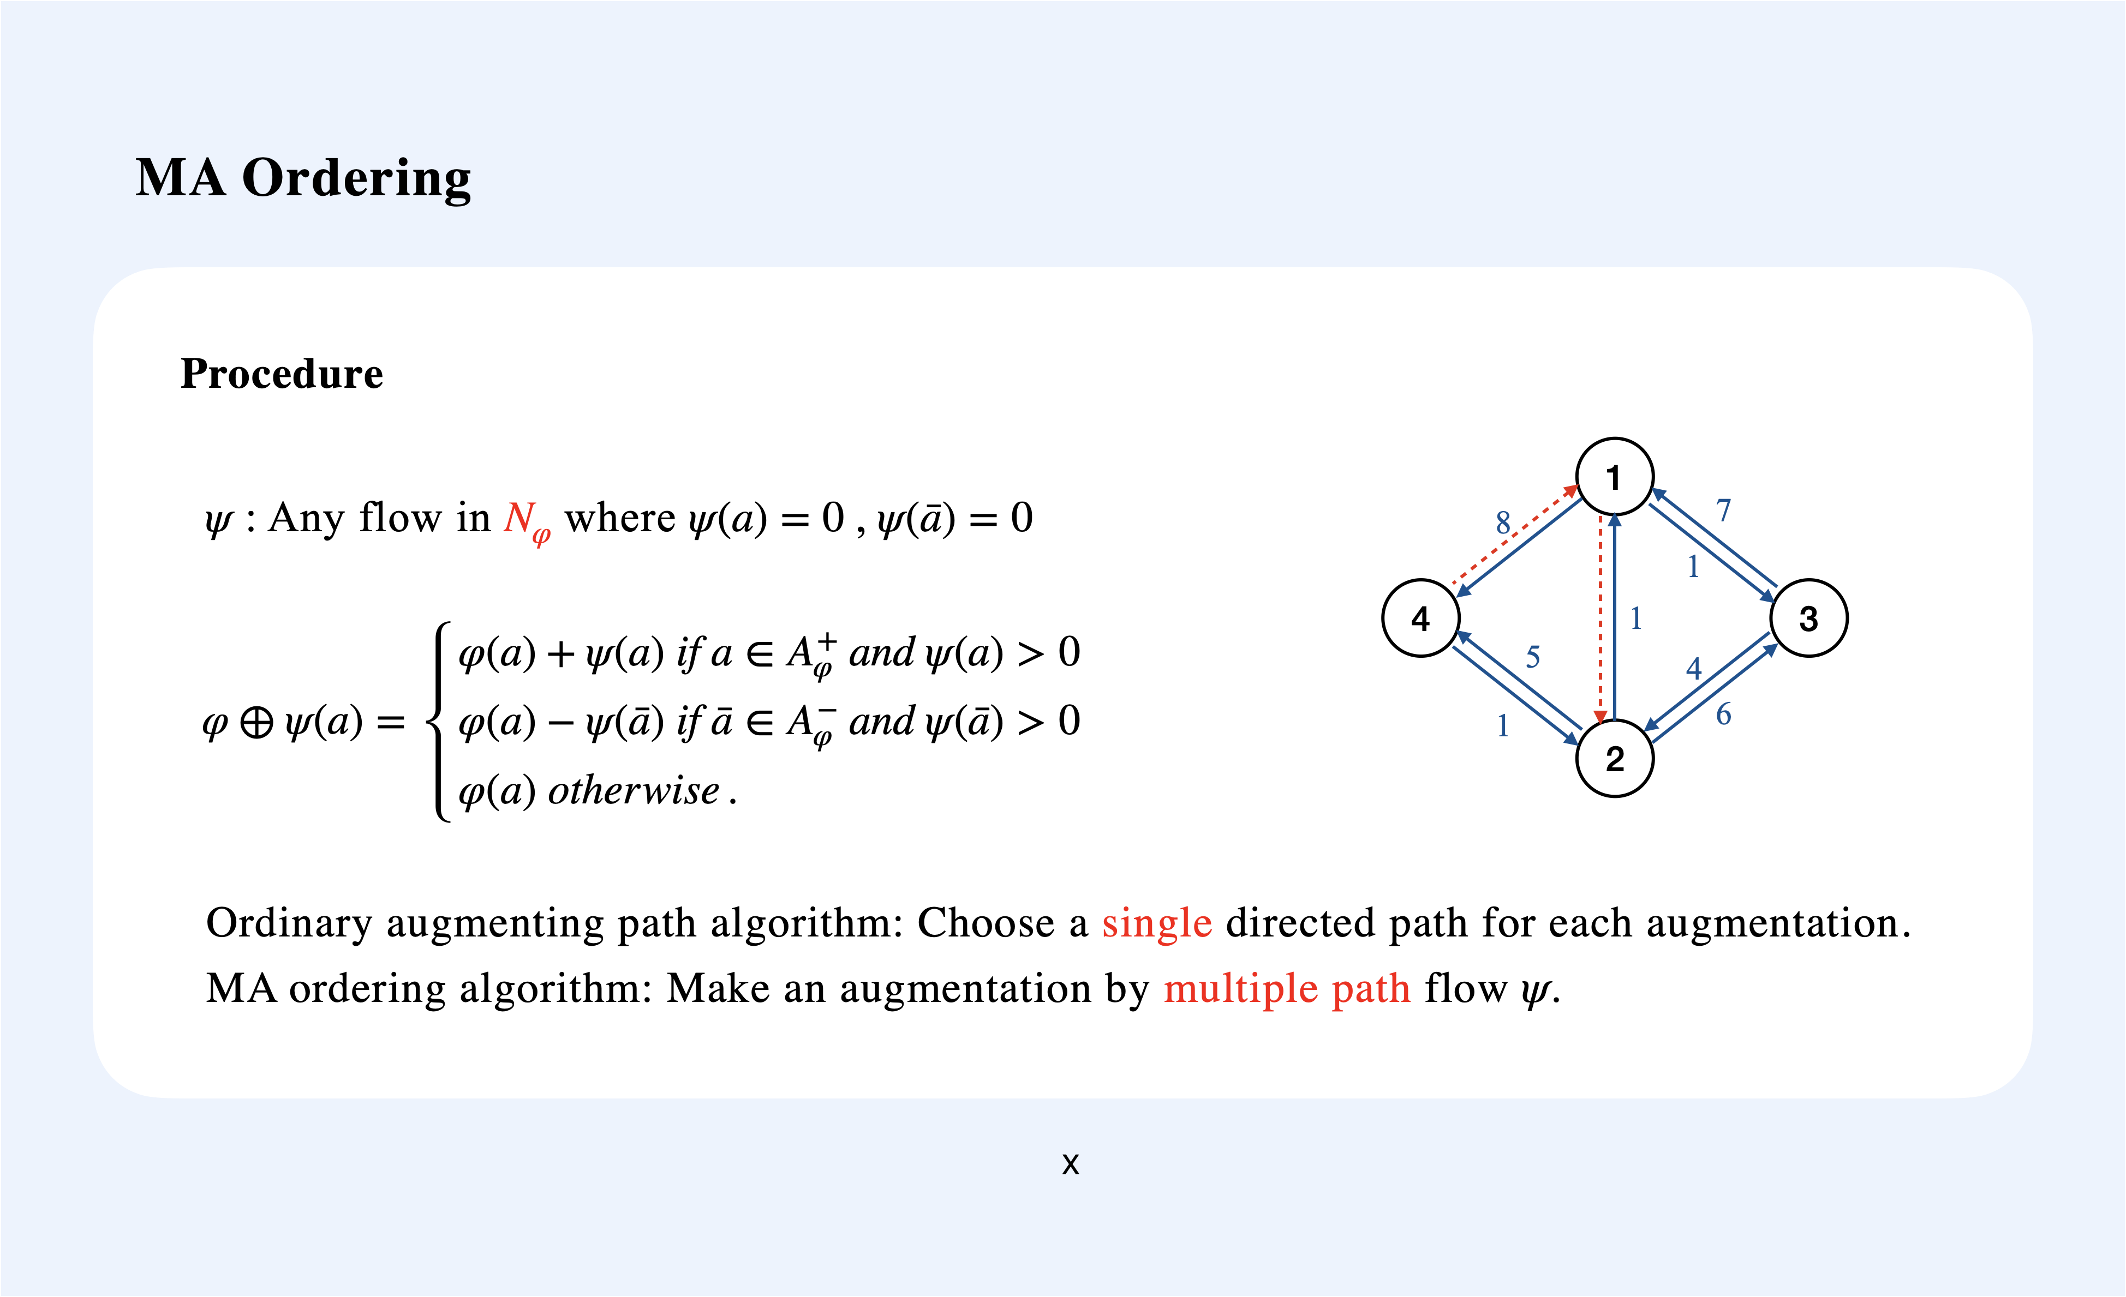

Slide 6
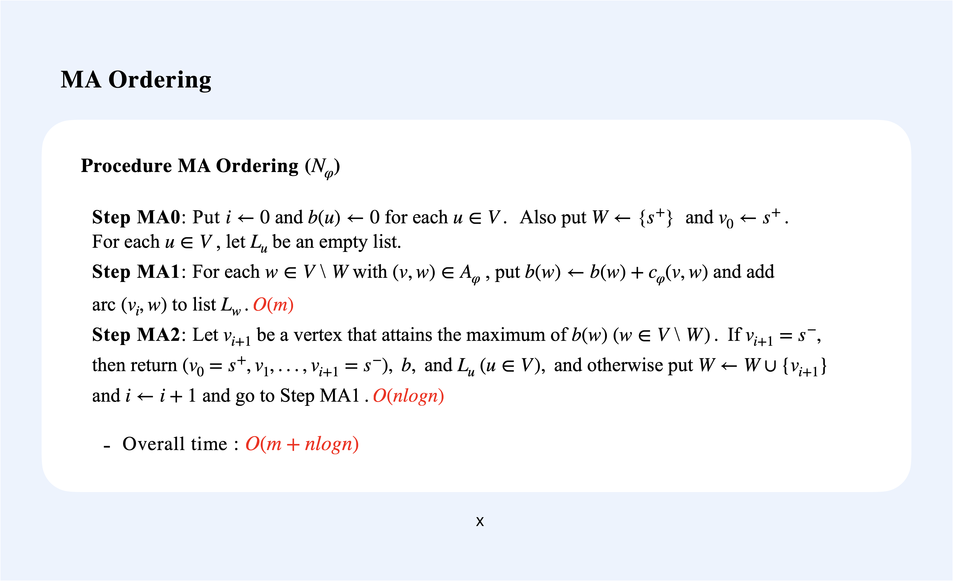

Slide 7
MA Ordering
Fibonacci Heap
MA ordering forms an acyclic subgraph $H_{φ}\text{of}{ G}_{φ}$, with using Fibonacci heap.
The vertex set $U=\{v_{0}=s^{+},v_{1},...,v_{i+1}=s^{−}\}$ gives a topological ordering.
Fibonacci heap: A min heap, not a binary heap.
Topological ordering:
0
1
2
3
17
24
3
4
5
18
52
38
30
26
46
6
7
8
39
41
35
0
1
5
4
8
3
6
7
2

Slide 8
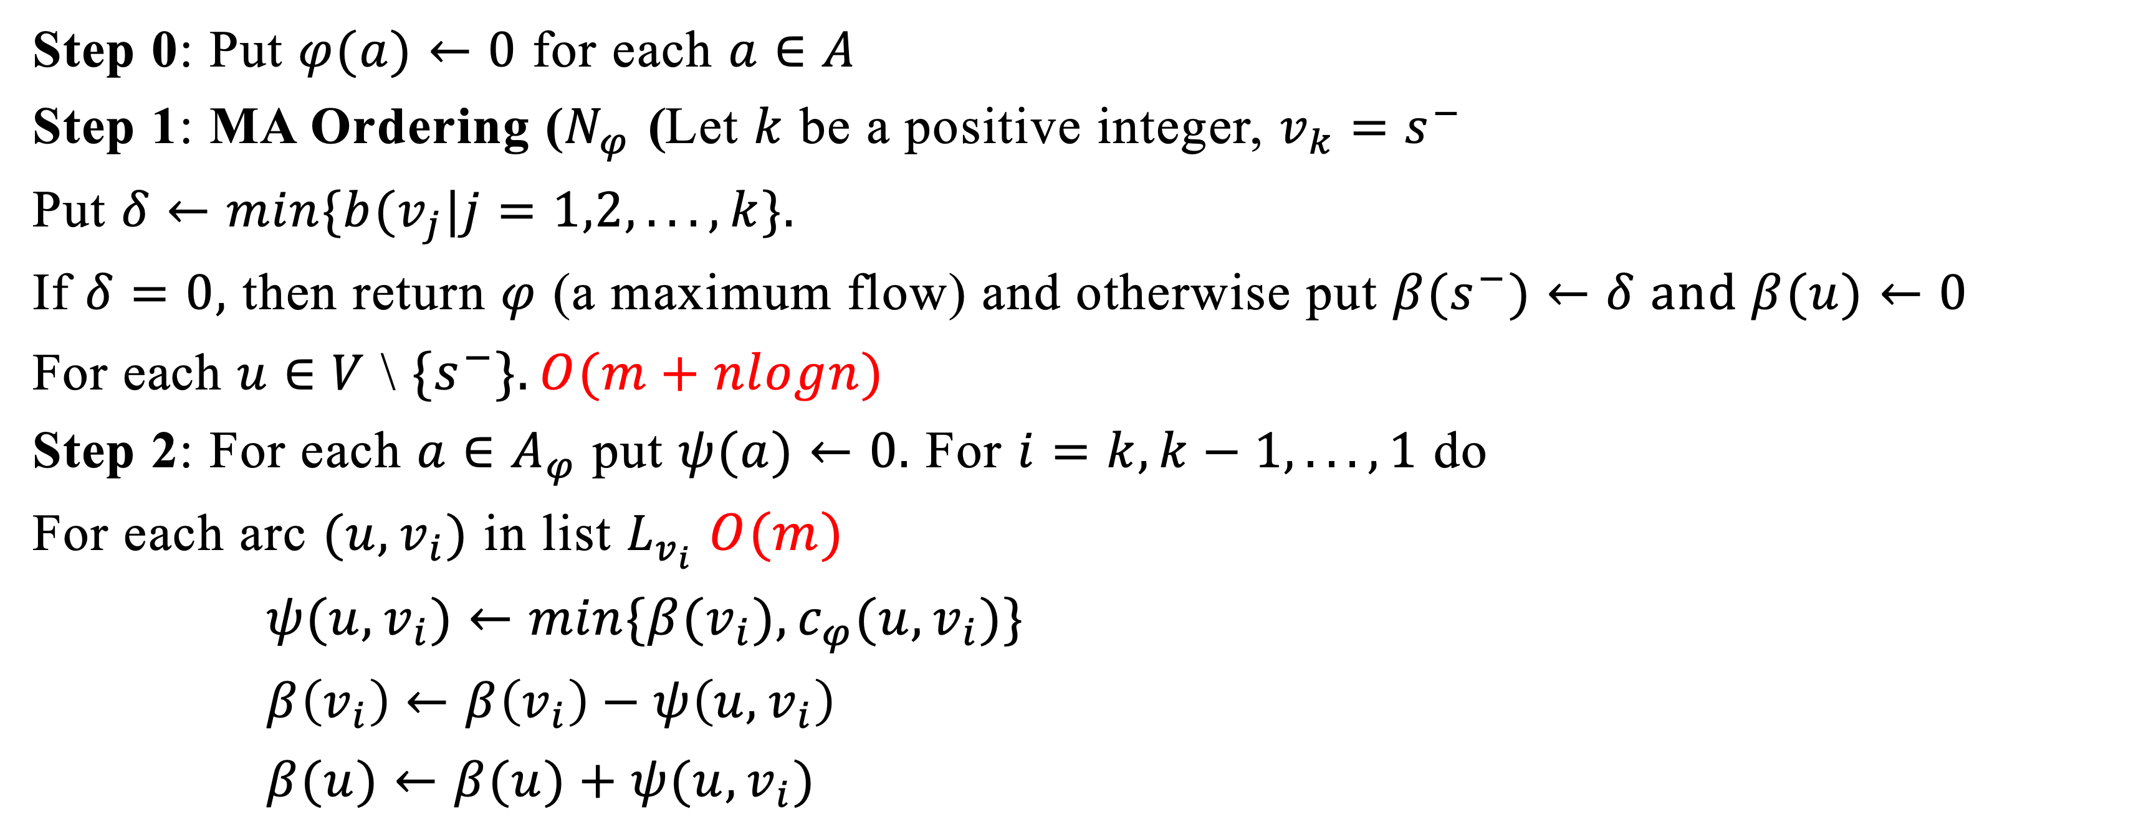
Maximum Flow Algorithm with MA Ordering
Algorithm
Step 0: Put $φ(a)←0$ for each $a∈A$
Step 1: MA Ordering ($N_{φ}$) Let $k$ be a positive integer, $v_{k}=s^{−}$
Put $δ←min\{b(v_{j}|j=1,2,...,k\}.$
If $δ=0,$ then return $φ$ (a maximum flow) and otherwise put $β(s^{−})←δ$ and $β(u)←0$
For each $u∈V$ \ $\{s^{−}\}.O(m+nlogn)$
Step 2: For each $a∈A_{φ}$ put $ψ(a)←0.$ For $i=k,k−1,...,1$ do
For each arc $(u,v_{i})$ in list $L_{v_{i}}$ $O(m)$
$ψ(u,v_{i})←min\{β(v_{i}),c_{φ}(u,v_{i})\}$
$β\left(v_{i}\right)←β\left(v_{i}\right)−ψ\left(u,v_{i}\right)$
$β(u)←β(u)+ψ(u,v_{i})$

Slide 9
Maximum Flow Algorithm with MA Ordering
Algorithm
Step 3: Put $φ←φ⊕ψ.$ Go back to Step 1. $O(m)$
Complexity
$δ=b(v_{i})$, when $v_{i}$ is chosen, use the current $b$.
$∑\{c_{φ}(u,w)|u∈W, w∈V$ \ $W, (u,w)∈A_{φ}\}=\underset{w∈V\backslash W}{∑}b(w)≤|V\backslash W|b(v_{i})$

Slide 10
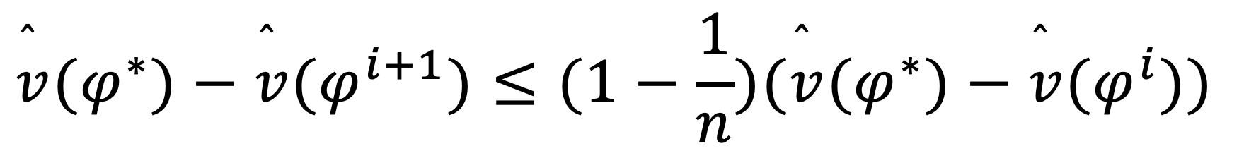
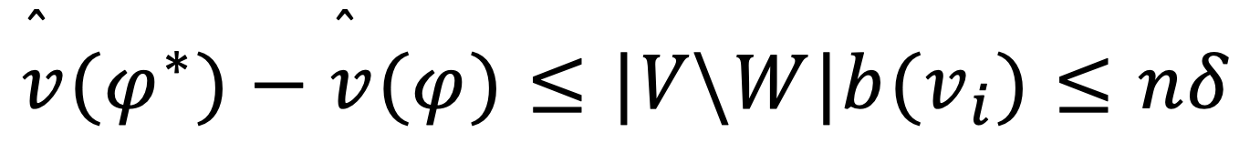
Maximum Flow Algorithm with MA Ordering
Complexity
Since $\overset{̂}{v}(φ^{∗})−\overset{̂}{v}(φ)$ is the value of the maximum flow in residual network $N_{φ}$,
$$\overset{̂}{v}(φ^{∗})−\overset{̂}{v}(φ)≤|V\backslash W|b(v_{i})≤nδ$$
At the end of the $i$th execution of Step 3, the flow $φ$ denoting by $φ^{(i)}$:
$$\overset{̂}{v}(φ^{∗})−\overset{̂}{v}(φ^{i+1})≤(1−\frac{1}{n})(\overset{̂}{v}(φ^{∗})−\overset{̂}{v}(φ^{i}))$$
Every $O(n)$ iterations of Step 1~3 have at least $\overset{̂}{v}(φ^{∗})−\overset{̂}{v}(φ)$ difference.

Slide 11
Maximum Flow Algorithm with MA Ordering
Complexity
Since originally, $\overset{̂}{v}(φ^{∗})−\overset{̂}{v}(φ)≤nU−0$, repeat Step 1~3 for $O(nlognU)$ times.
Overall time : $O(m+nlogn)$ multiply $O(nlognU)$ = $O(n(m+nlogn)lognU)$
time
# times
Faster than maximum-capacity augmenting path,$∵O(mlogU)$ < $O(nlognU)$ augmentations.

Slide 12
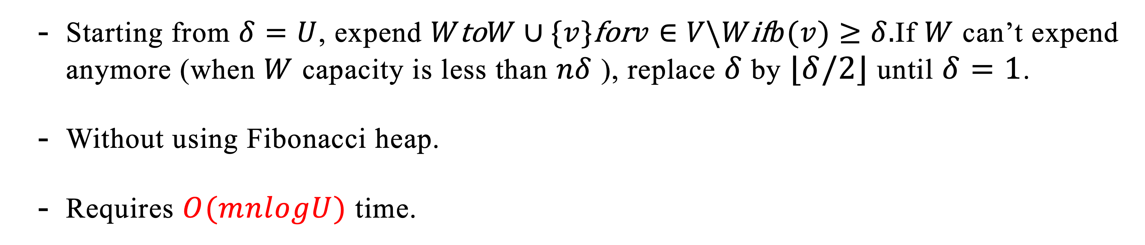
MA Ordering : Scaling Algorithm
MA Ordering : Scaling Algorithm
Starting from $δ=U$, expend $W\text{to}W∪\{v\}\text{for}v∈V\backslash W\text{if}b(v)≥δ.$If $W$ can’t expend anymore (when $W$ capacity is less than $nδ$ ), replace $δ$ by $⌊δ/2⌋$ until $δ=1$.
Without using Fibonacci heap.
Requires $O(mnlogU)$ time.

Slide 13
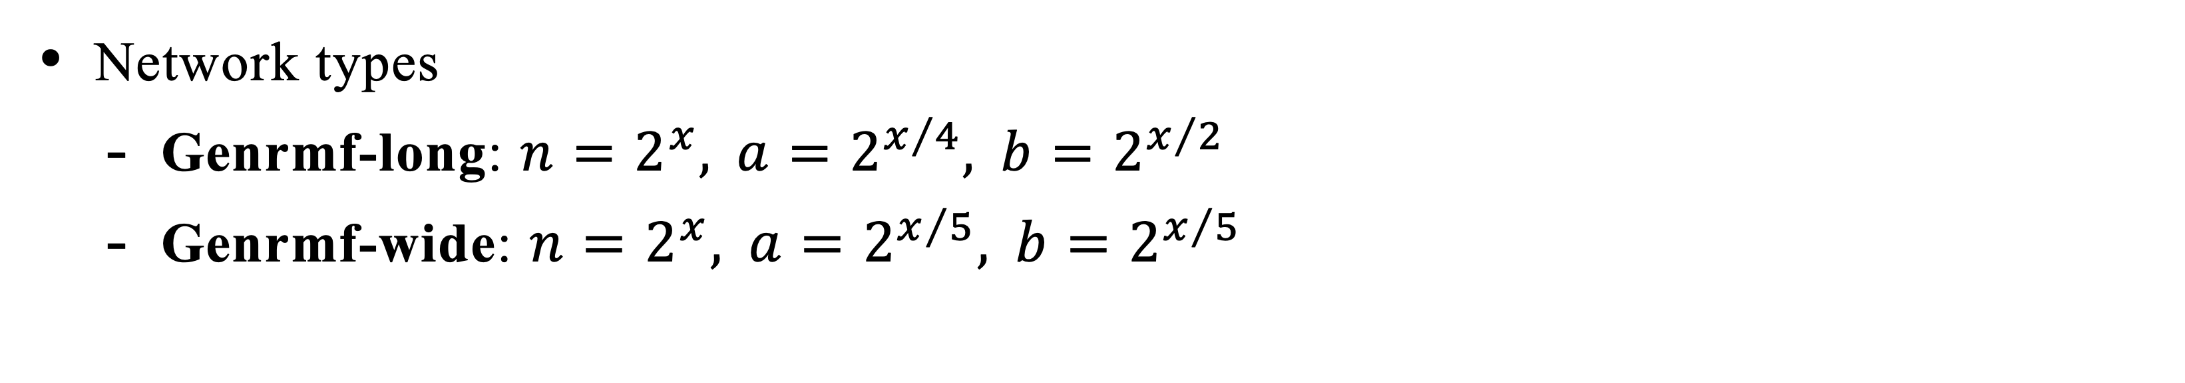
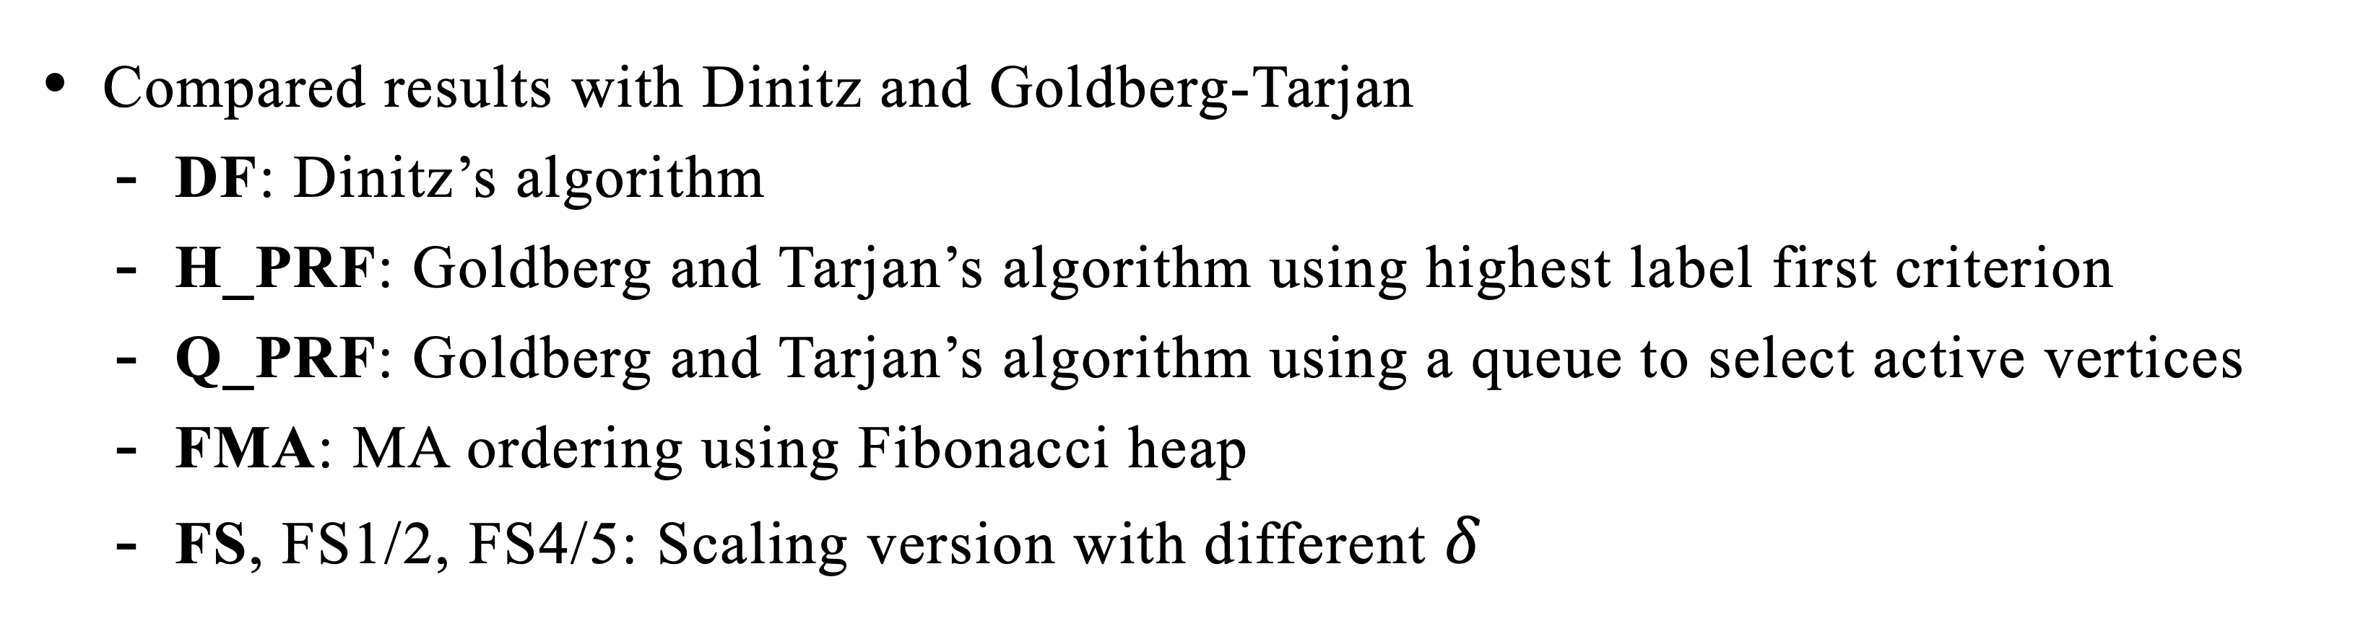
Computational Results
Setup
Compared results with Dinitz and Goldberg-Tarjan
DF: Dinitz’s algorithm
H_PRF: Goldberg and Tarjan’s algorithm using highest label first criterion
Q_PRF: Goldberg and Tarjan’s algorithm using a queue to select active vertices
FMA: MA ordering using Fibonacci heap
FS, FS1/2, FS4/5: Scaling version with different $δ$
Network types
Genrmf-long: $n=2^{x}, a=2^{x/4}, b=2^{x/2}$
Genrmf-wide: $n=2^{x}, a=2^{x/5}, b=2^{x/5}$

Slide 14
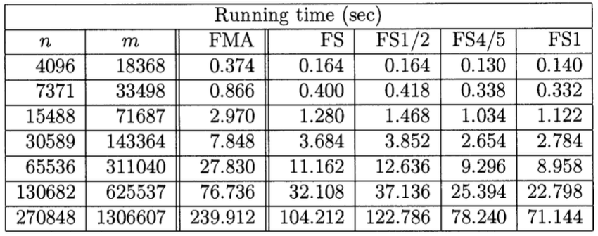
Computational Results
Experiment Results
FS1 performs the best.
Results on Genrmf-long family data

Slide 15
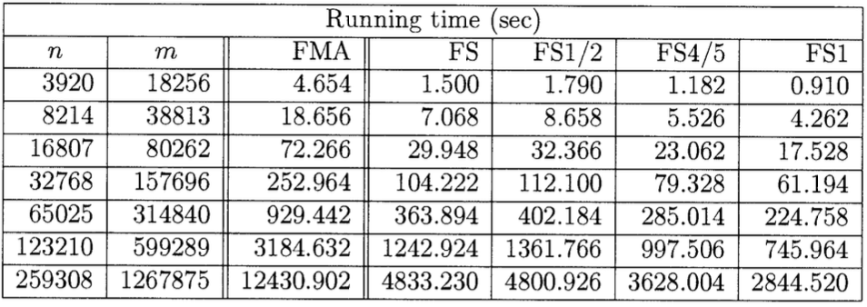
Computational Results
Experiment Results
FS1 performs the best.
Results on Genrmf-wide family data

Slide 16
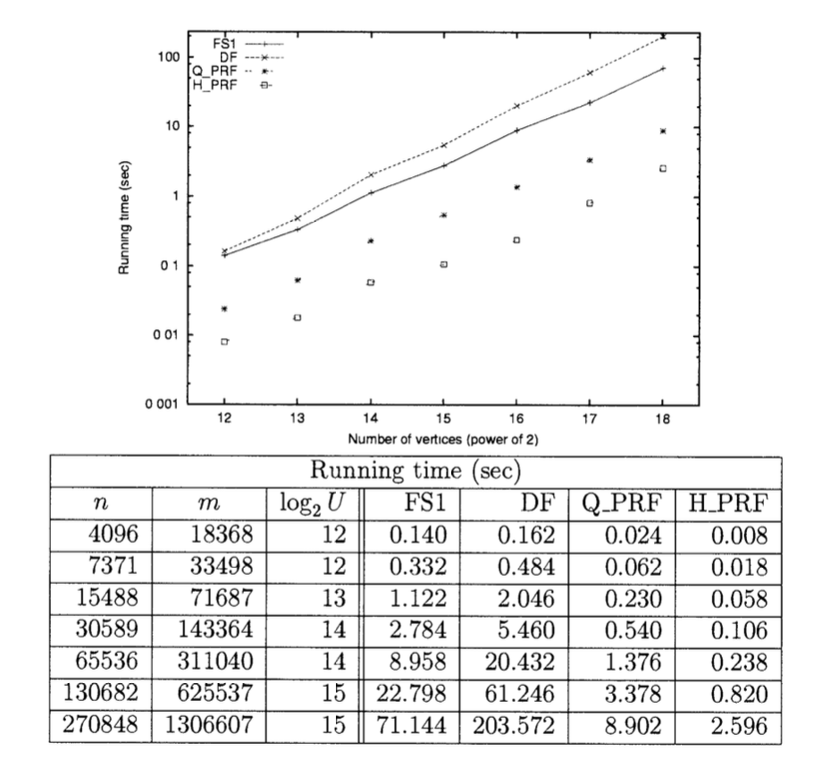
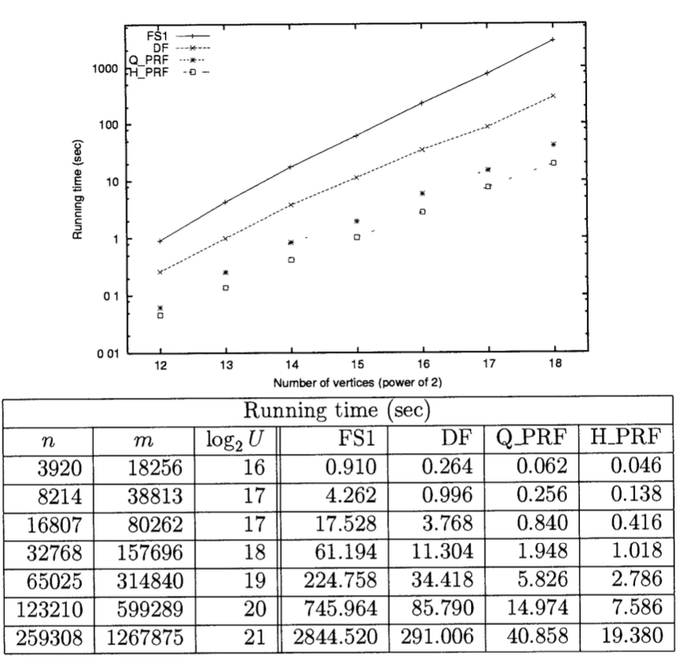
Computational Results
Experiment Results
Goldberg and Tarjan algorithm still performs better.
Results on Genrmf-long family data
Results on Genrmf-wide family data

Slide 17
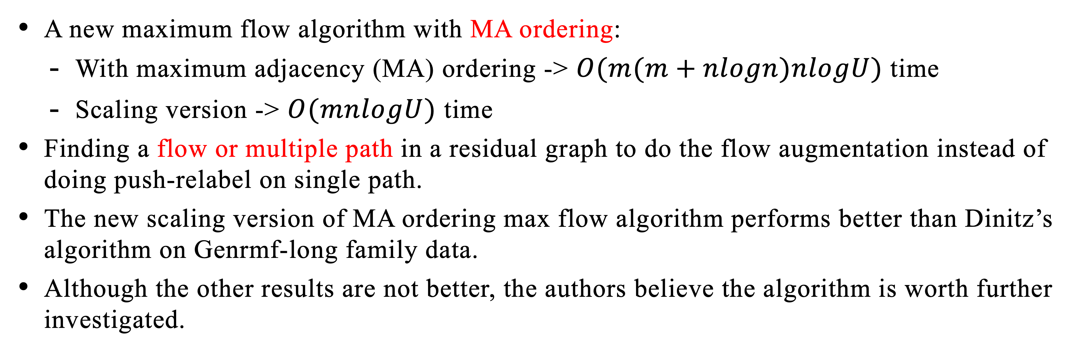
Conclusion
A new maximum flow algorithm with MA ordering:
With maximum adjacency (MA) ordering -> $O(m(m+nlogn)nlogU)$ time
Scaling version -> $O(mnlogU)$ time
Finding a flow or multiple path in a residual graph to do the flow augmentation instead of doing push-relabel on single path.
The new scaling version of MA ordering max flow algorithm performs better than Dinitz’s algorithm on Genrmf-long family data.
Although the other results are not better, the authors believe the algorithm is worth further investigated.

Slide 18
THANKS FOR LISTENING

